Slide 1
MalSim
Building Covert Telecom Trackers with Malicious eSIM Profiles

Slide 2

Presenter
Ravi Rajput
Principal Architect Information Security– NeoTech Global PVT LTD
Cybersecurity Expert | Creator of AutoHackOS | DEFCON Village Organizer
Core Expertise:
Telecom and Automotive Cybersecurity
Vulnerability Research (Windows, Linux, ARM)
Reverse Engineering & Advanced Penetration Testing.
Contributions:
Developed AutoHackOS, a globally adopted automotive pentesting OS, launched at Black Hat
Millions of downloads by researchers and OEM testers worldwide
Recognized for tool innovation in vehicle telematics and firmware analysis.
Community Roles:
Core Team member at DEFCON Telecom Village
Speaking Engagements: Presented at DEFCON, BLACKHAT, HITB, Nullcon, HITCON and several Bsides Conferences.

Slide 3
Agenda
Introduction
Background
eSIM Architecture & API Surface
Malware Workflow
Code Deep Dive
Telecom Backend Vulnerabilities
Detection & Defense

Slide 4
I get scared when someone said: “I know where are you”

Slide 5
Background
Telecom APIs, once tightly restricted, are now partially exposed via Android system services.
Malicious apps can exploit these APIs for covert metadata harvesting and profile manipulation.
eSIM allows silent over-the-air provisioning — a powerful attack vector if misused.
Rooted Android environments + system permissions = ideal conditions for SIM-based malware.

Slide 6
eSIM Architecture
eSIM (via eUICC) enables Remote SIM Provisioning (RSP)—operating without a physical SIM card
eSIM architecture supports multiple profiles concurrently; only one is active at a time
Profile management (install, enable, disable, delete) is handled by a component called Local Profile Assistant (LPA) on the device
The device communicates with carrier provisioning backends via:
SM‑DP+ (Subscription Manager – Data Preparation)
Optionally SM‑DS (Discovery Server) or GSMA Discovery service
Communication is end‑to‑end encrypted between SM-DP+ and eUICC; only the eUICC can decrypt and install the profile securely

Slide 7
Android API Surface
EuiccManager / TelephonyManager in Android framework let apps query and manage eSIM profiles (install, enable, delete)
iccOpenLogicalChannel()/iccTransmitApduLogicalChannel() allow low-level APDU communication with physical SIM and eSIM
LPA communicates with SM-DP+ using system services; typical apps call into EuiccManager APIs, often requiring system or root privileges

Slide 8
GSMA-defined eSIM architectures
M2M Architecture (Machine-to-Machine)
Designed for devices without user interfaces (e.g., vehicles, utility meters).
Remote SIM provisioning initiated and controlled exclusively by the operator.
Key components: SM-DP, SM-SR, and eUICC.
Push model: Operator pushes encrypted profiles to the device over-the-air.
Supports emergency call use cases like eCall in vehicles.
Profiles can be remotely enabled, disabled, or deleted without user interaction.
Ideal for automotive, industrial, and M2M deployments.

Slide 9
GSMA-defined eSIM architectures
Consumer Architecture
Tailored for smartphones, tablets, and wearables with a user interface.
Full control is in the hands of the end user (install, switch, delete profiles).
Components include SM-DP+, SM-DS, LPA, and eUICC.
Pull model: User scans QR code or uses a discovery server to download profiles.
Enables multiple active profiles on one device (e.g., dual SIM).
Facilitates global roaming, waterproof designs, and space-saving hardware.

Slide 10
GSMA-defined eSIM architectures
IoT Architecture
Designed for network-constrained or screen-less IoT devices.
Based on Consumer spec but adds two key modules:
eIM (IoT Remote Manager): Remotely triggers install/enable/disable actions.
IPA (IoT Profile Assistant): Local proxy handling secure profile exchange.
Pull model managed by a remote enterprise entity (e.g., IoT OEM).
Profiles downloaded securely and automatically provisioned without user intent.
Supports fleet management, bulk provisioning, and remote SIM lifecycle ops.
Ideal for LPWAN, NB-IoT, and other enterprise IoT deployments.

Slide 11
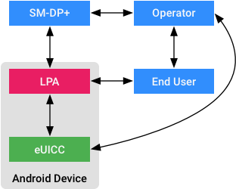
Android eSIM Architecture
Key components
SM-DP+ (Subscription Manager - Data Preparation+) • Secure backend server operated by MNOs. • Prepares encrypted eSIM profiles for download.
LPA (Local Profile Assistant) • A system component in Android (part of the OS). • Communicates with SM-DP+ to fetch and install eSIM profiles. • Handles QR code scanning, profile activation/deletion.
eUICC (Embedded UICC) • Hardware chip storing multiple eSIM profiles securely. • Can switch between profiles without physical SIM change.
End User • Initiates actions like scanning QR code or selecting profiles.
Operator • Controls profile issuance and manages entitlements.

Slide 12
Workflow
User initiates profile installation (e.g., scanning QR code).
LPA contacts SM-DP+ to request profile.
SM-DP+ delivers encrypted profile to the LPA.
LPA writes the profile securely to eUICC.
eUICC activates profile and connects to carrier.

Slide 13
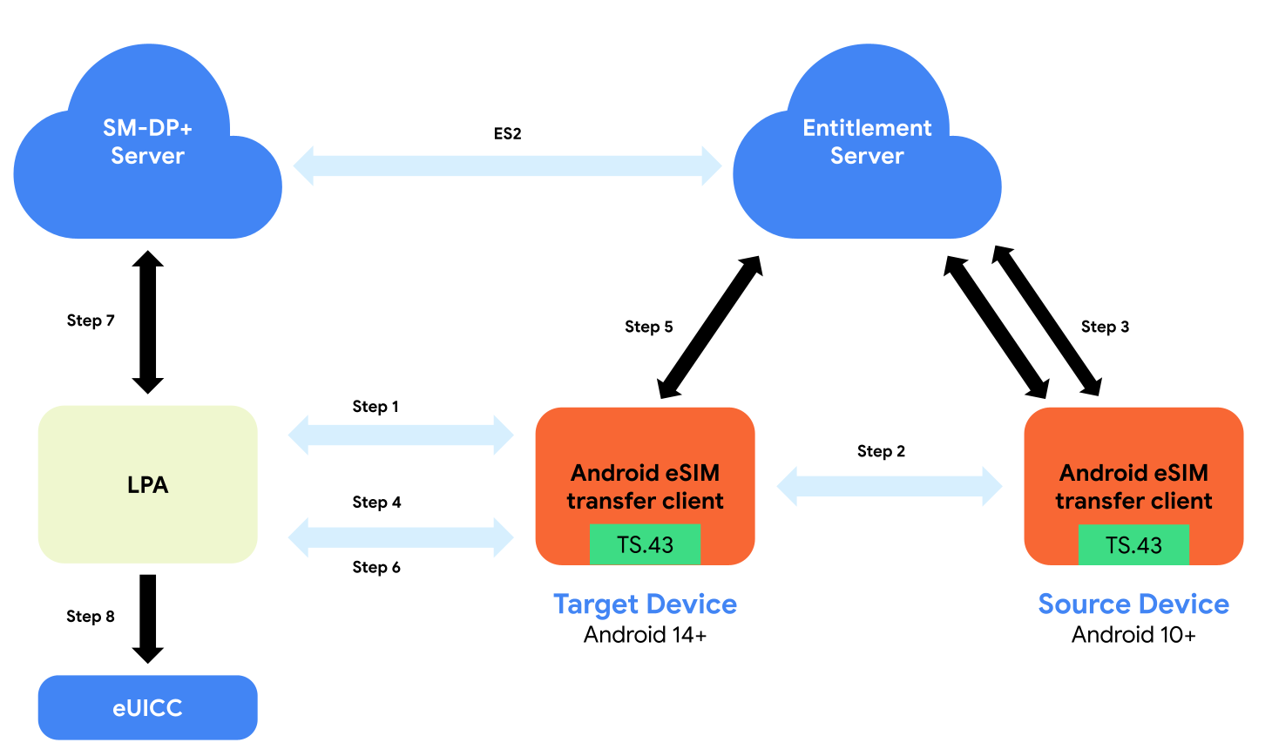
eSIM Transfer carrier integration
User signs in to Google account on the new device.
Android checks with the user's carrier for available transferable eSIM profiles.
Carrier validates identity & authorizes transfer session.
LPA (Local Profile Assistant) on the new device connects to carrier backend via SM-DS.
LPA downloads and installs the eSIM profile securely into the eUICC.
Old device’s profile is deactivated or deleted post-transfer (based on carrier policy).

Slide 14
Android System Interfaces for eSIM & SIM Profile Control
EuiccManager:
Core class for managing eSIM profiles.
Handles download, delete, enable/disable, and switch operations.
Communicates with LPA → SM-DP+ backend (carrier’s subscription manager).
TelephonyManager:
Grants access to physical SIM operations (e.g., IMSI, ICCID, APDU via logical channels).
Interfaces with UICC hardware using AID (Application Identifier).
Required for sending APDU commands to retrieve hidden SIM data.
CarrierConfigManager:
Manages per-carrier behavior overrides.
Determines rules for auto-activation, eSIM policy, and carrier-specific capabilities.

Slide 15
Backend Relationships: SM-DP+, SM-SR
SM-DP+ (Subscription Manager – Data Preparation):
Delivers the encrypted eSIM profile to the device.
Communicates with LPA via EuiccManager.
SM-SR (Subscription Manager – Secure Routing):
Controls the lifecycle of eSIM profiles (enable, disable, delete).
Handles secure channel establishment with the eUICC.

Slide 16
UICC, AID, and APDU — How Android Talks to SIMs
UICC:
The smart card module that contains SIM/eSIM profiles.
Accessed using TelephonyManager via logical channels.
AID (Application Identifier):
Unique identifier for apps on SIM (e.g., USIM, ISIM).
Required for channel opening to specific SIM apps.
APDU (Application Protocol Data Unit):
Low-level command interface to UICC/eUICC.
Used to query or manipulate SIM data silently.
Can be abused to extract metadata or manipulate state without user interaction.

Slide 17
Malware Workflow
1. App Launches Silently (Background Service)
Starts on boot or via background trigger (e.g., BOOT_COMPLETED, FOREGROUND_SERVICE).
Registers necessary broadcast receivers for SIM change or connectivity.
2. Privilege Escalation or Exploitation
Uses root access or exploits provisioning loopholes.
Attempts silent systemization or elevation to gain MODIFY_PHONE_STATE or carrier-level privileges.
3. Silent eSIM Profile Installation
Abuses EuiccManager.downloadSubscription() to install a malicious or controlled eSIM profile.
Communicates directly with SM-DP+ backend without user prompt (if improperly secured).

Slide 18
Malware Workflow
4. Background Profile Activation and Stealth Persistence
Automatically switches to malicious profile via EuiccManager.switchToSubscription().
Removes UI prompts by simulating carrier triggers or using privileged APIs.
5. Covert Data Exfiltration
Extracts IMSI, ICCID, and network metadata using TelephonyManager.
Sends low-level APDU commands via iccOpenLogicalChannel() to fetch identifiers and hidden data.
Leverages eSIM events to track location, cell tower ID, and call logs.
6. Exfiltrates Data to C2 Server
Periodically transmits metadata to a remote server over stealth channels.
May use DNS tunneling, covert SMS, or encrypted HTTPS with domain fronting.
7. Anti-Forensics and Persistence
Hides malicious profile among others, renames identifiers.
Restores itself on boot or SIM switch.
Optionally registers itself as priv-app using RootSystemInstaller module

Slide 19
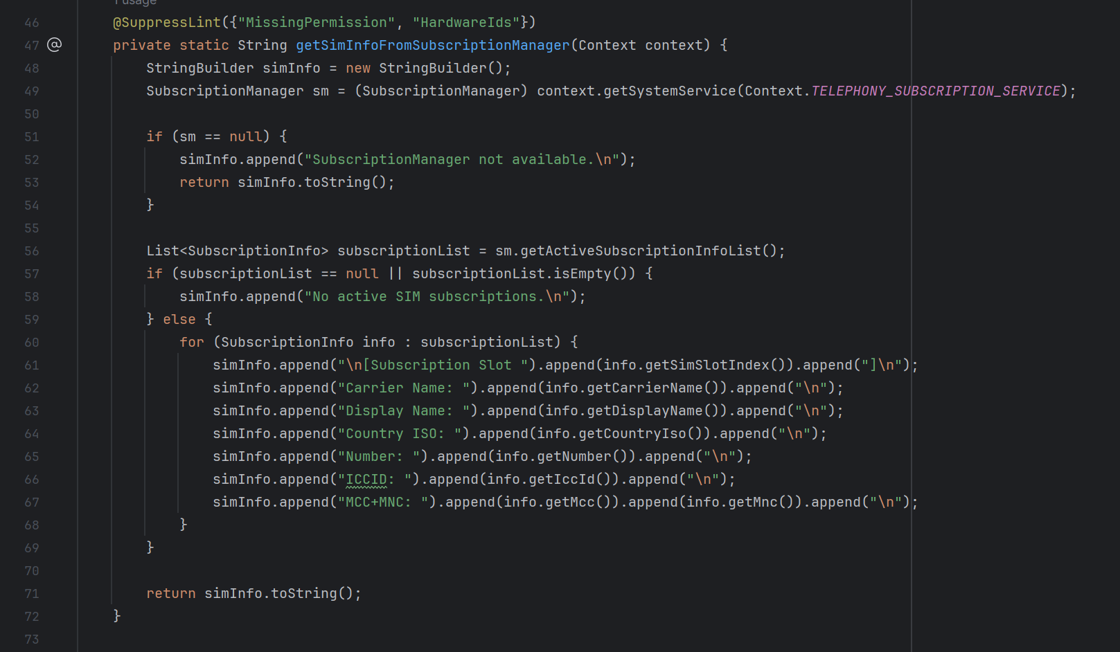
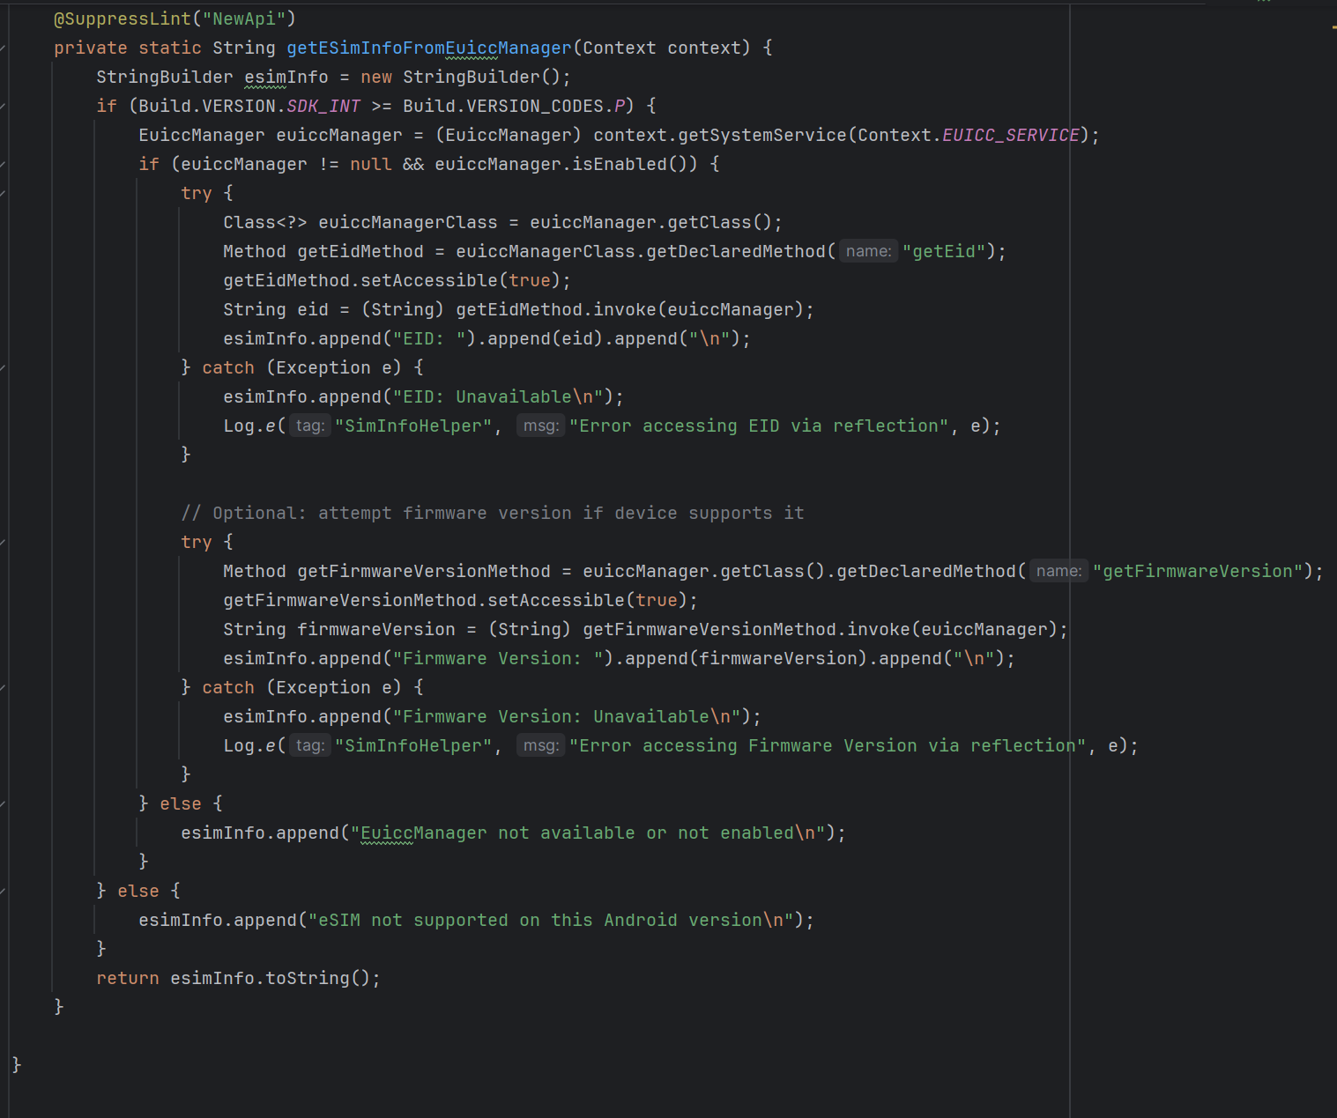
Code Deep Dive – Profile Harvesting
SIM Profile Extraction Logic
Fetches all active SIM/eSIM profiles using SubscriptionManager.getActiveSubscriptionInfoList()
Iterates over each active subscription to extract:
Display Name, Carrier Name, MCC, MNC
ICCID, Country, Roaming Status
SIM slot index & logical slot association
Uses TelephonyManager to map subscription ID to:
IMEI, IMSI, Phone Number, Subscriber ID

Slide 20
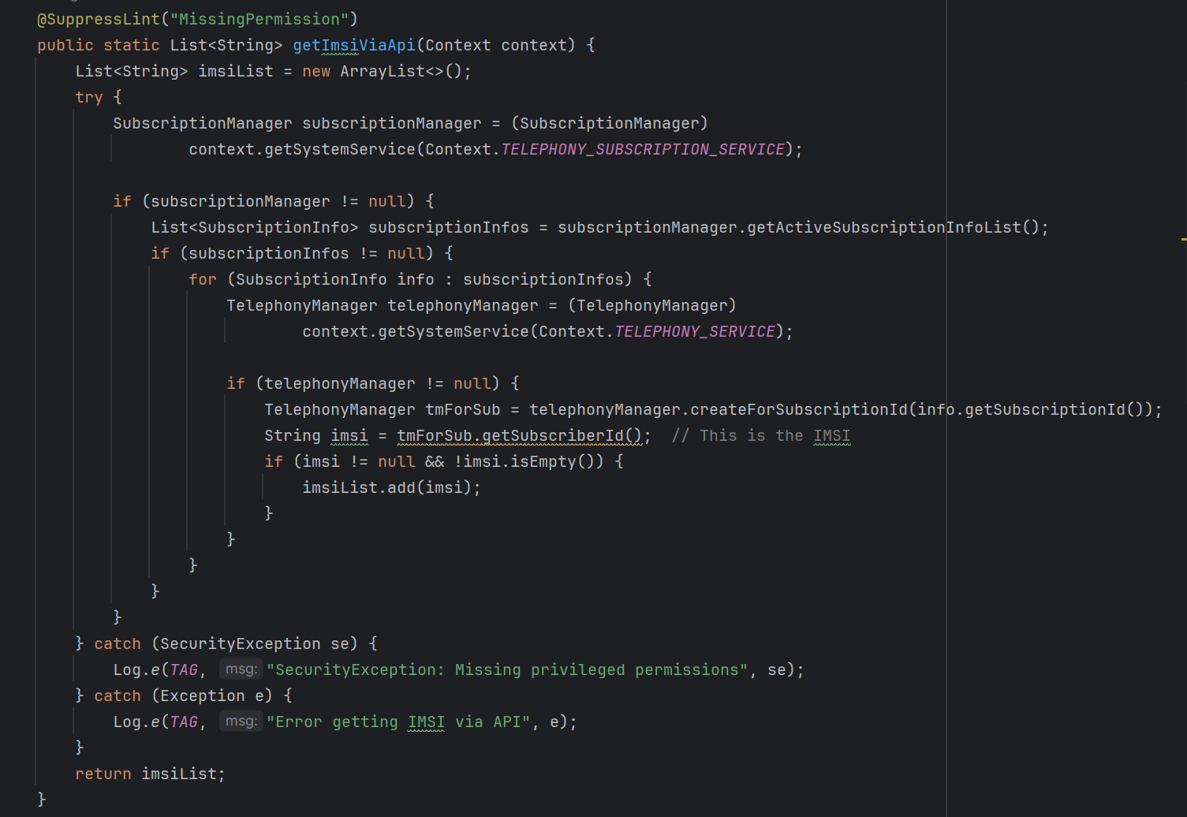
Code Deep Dive – Profile Harvesting
Differentiating eSIM vs Physical SIM
Uses SubscriptionInfo.isEmbedded() to check:
true = eSIM
false = Physical SIM
Manifest required permissions:
READ_PHONE_STATE, READ_PRIVILEGED_PHONE_STATE (system-only)
MODIFY_PHONE_STATE (if silently modifying subscriptions)

Slide 21
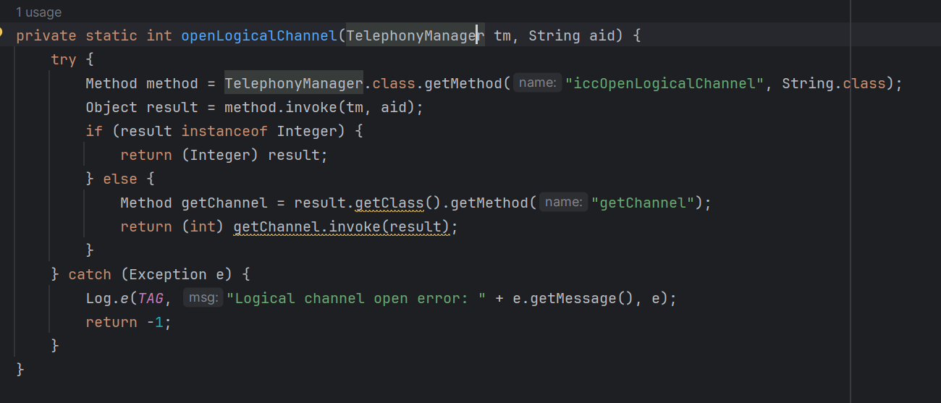
Code Deep Dive – APDU Access to SIM Files
What is APDU?
APDU (Application Protocol Data Unit) = low-level command sent directly to SIM/eSIM
Used for:
File system navigation (e.g., 00A400)
Reading SIM EF files (e.g., 00B0, 00C0)
Selecting apps on SIM (AID targets)
Physical SIM Access Logic
Uses TelephonyManager.iccOpenLogicalChannel() to access UICC AID
APDU commands sent using:
iccTransmitApduLogicalChannel(channelId, cla, ins, p1, p2, len, data)
Closes channel after response: iccCloseLogicalChannel(channelId)
Handles common APDU sequences like:
Select MF (00A4000C023F00)
Read Binary (00B0000009)
Get Response (00C0000000)

Slide 22
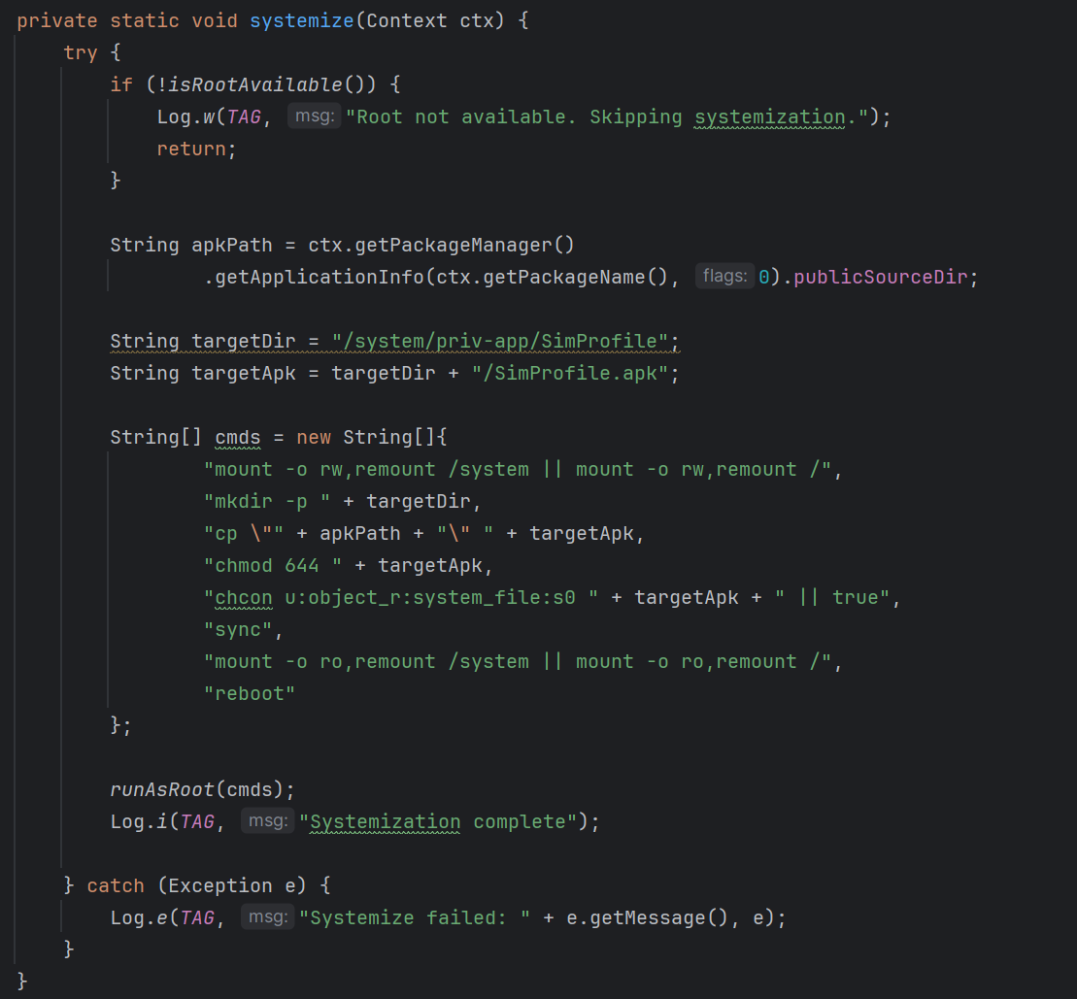
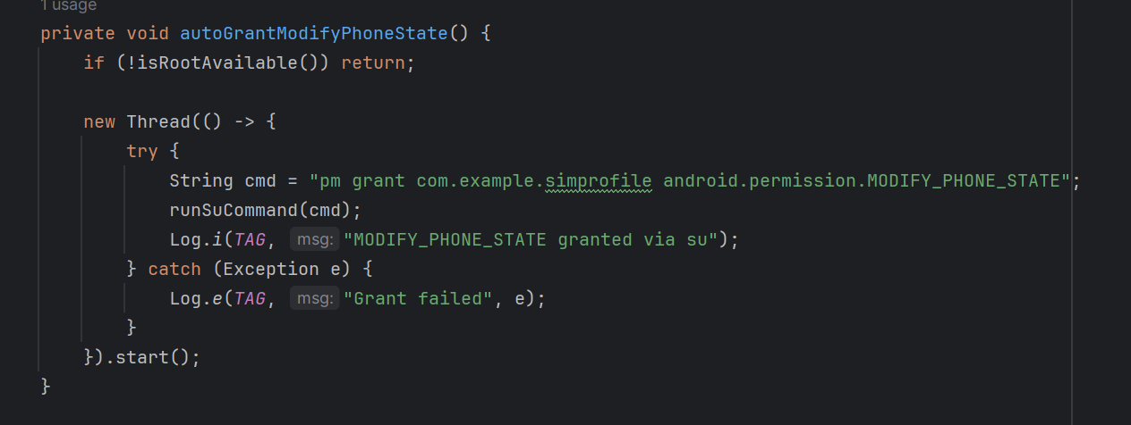
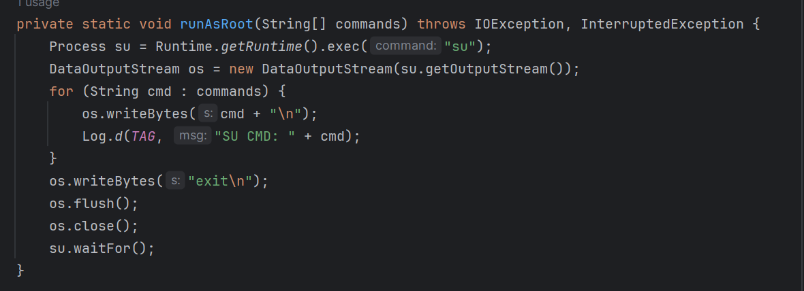
Code Deep Dive – Auto-Privilege Escalation & Persistence
Root Automation Workflow
Detects root via common SU paths (/system/bin/su, etc.)
If root is present and not a system app:
Mounts /system as writable
Creates /system/priv-app/SimProfile/
Copies own APK to this folder
Sets permissions & SELinux context
Triggers reboot for activation

Slide 23
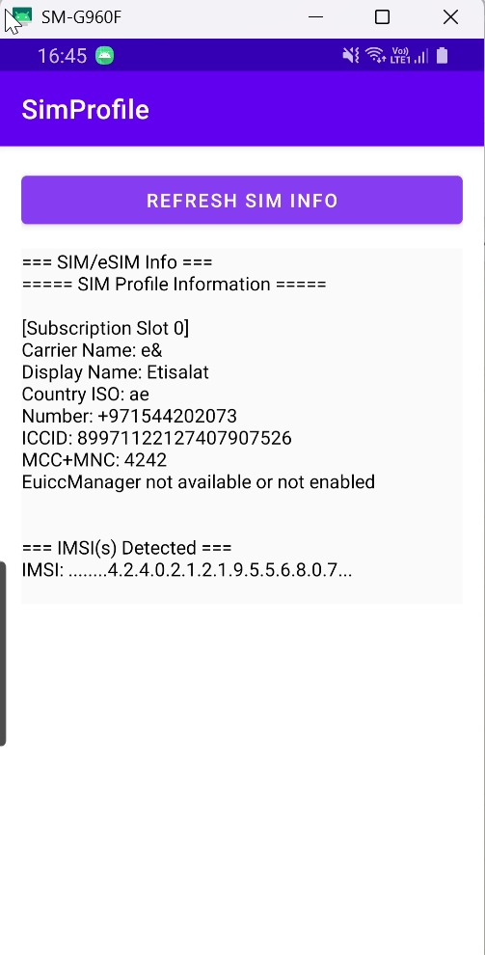
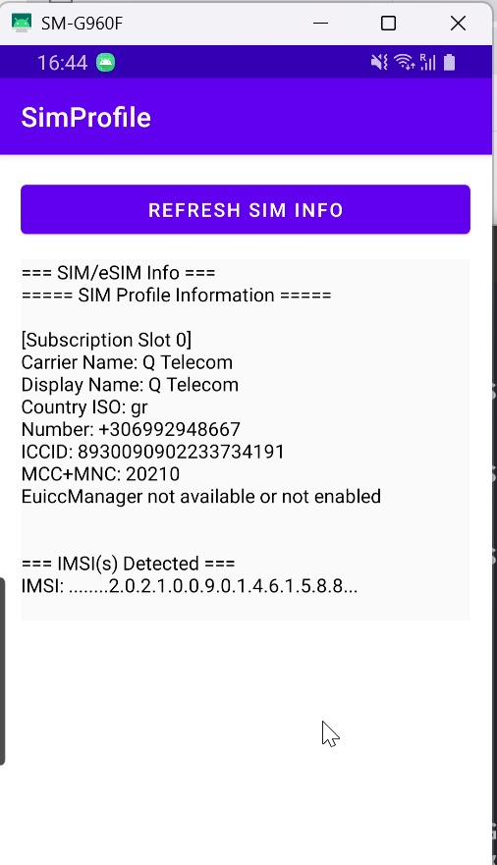
PoC

Slide 24
Detection Strategies
Behavioral Monitoring (Device & Network)
Track sudden SIM profile changes (e.g., ICCID, IMSI, operatorName)
Monitor SIM switch frequency and location jump patterns
Telemetry Signals from Device
Use Telemetry SDKs to watch:
EuiccManager.downloadSubscription() calls
TelephonyManager.iccOpenLogicalChannel() misuse
High-frequency access to getSubscriberId(), getSimSerialNumber()
Alert on silent APDU execution not associated with UI action

Slide 25
Thank You @infosecravi @frustratedresearcher

